Slide 1
WELCOME
TO OUR PRESENTATION

Slide 2


Slide 3

Aim:
.
The aim of the project is to predict whether a client will subscribe to a term deposit based on the
data from a Portuguese banking institution's direct marketing campaign. This helps in identifying the
most promising customers, allowing for more efficient and targeted marketing strategies, ultimately improving the conversion rate and optimizing resource allocation.
Scope of the project:
Analyzing data from direct marketing campaigns (phone calls).
Predicting customer conversion to term deposits.
Identifying key factors influencing customer decisions.
Creating a predictive model for targeted marketing.
Improving campaign efficiency by focusing on high-conversion prospects.

Slide 4
Objective:
Predict customer conversion: Identify customers most likely to subscribe to a term deposit.
Effective marketing: Use targeted phone calls to reach out to high-potential clients.
Optimize resources: Minimize investment in large call centers by focusing efforts on the most promising leads.
Data-driven decisions: Analyze past campaign data to improve customer targeting and campaign efficiency.
Tools Used:
Machine Learning
Python (for Data Cleaning)
Power BI (Visualization and Dashboard)

Slide 5
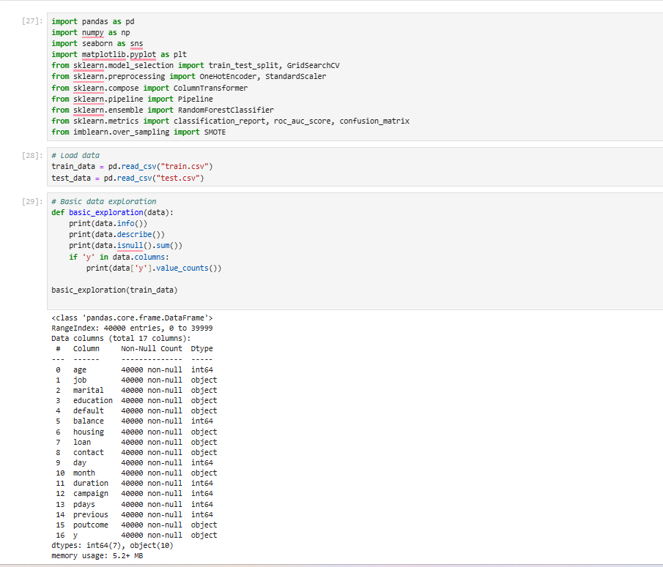
Code:
Imports libraries for data analysis (Pandas, NumPy), visualization (Matplotlib, Seaborn), machine learning (scikit-learn), and handling imbalanced data (imbalanced-learn).
Loads training and testing datasets from CSV files using pandas.
Defines a basic_exploration function to perform exploratory data analysis, including displaying data information, summary statistics, and missing values count.
Checks and prints the distribution of the target variable 'y' if present in the dataset.

Slide 6
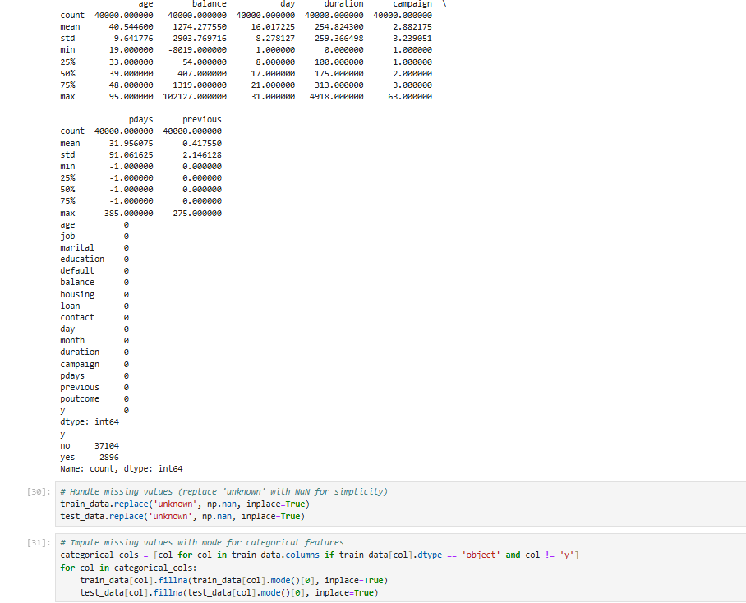
Displays statistical summary for numerical columns and counts of missing values in both the training and test datasets.
Replaces occurrences of 'unknown' with NaN in both
datasets for easier handling of missing values.
Identifies categorical columns in the training data that are not the target variable 'y'.
Imputes missing values in categorical columns by filling them with the mode (most frequent value) of each column for both training and test datasets.

Slide 7
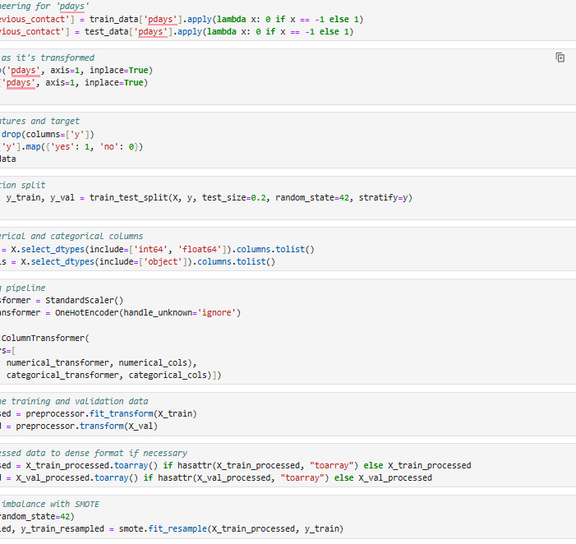
Performs feature engineering by transforming the 'pdays' column into a binary feature called 'previous_contact'.
Splits the dataset into features (X) and target (y), and
further splits into training and validation sets using stratified sampling.
Identifies numerical and categorical columns, and sets up a
preprocessing pipeline with a StandardScaler for numerical features and OneHotEncoder for categorical features.
Transforms the training and validation data using
the preprocessing pipeline, converting them to dense format if needed.
Handles class imbalance in the training data using SMOTE
(Synthetic Minority Over-sampling Technique) to generate
synthetic samples for the minority class.

Slide 8
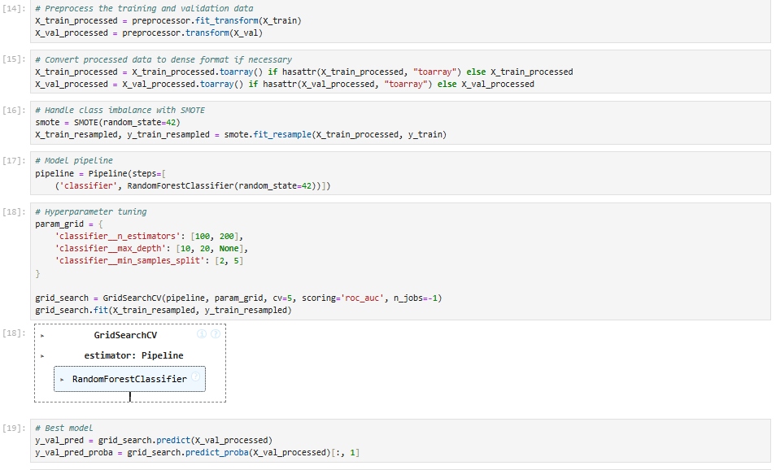
Preprocesses training and validation data with a
transformer and converts sparse data to dense if needed.
Handles class imbalance using SMOTE to oversample
the minority class.
Creates a pipeline with a Random Forest Classifier as the model.
Tunes hyperparameters (n_estimators, max_depth, min_samples_split) using GridSearchCV with AUC scoring.
Uses the best model to make predictions and compute
probabilities on the validation data.

Slide 9
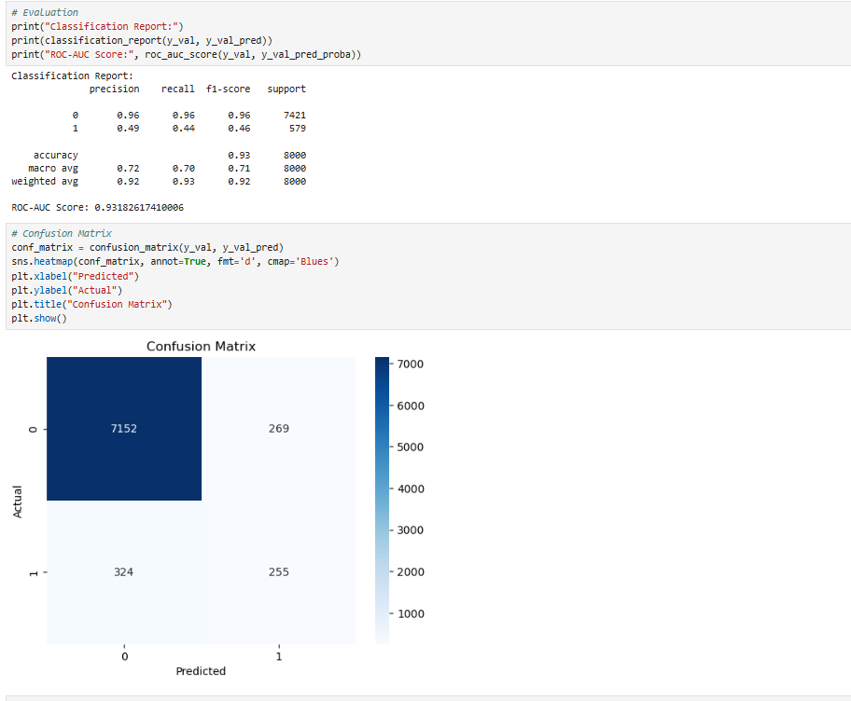
Classification Report: Precision, recall, F1-score, and support metrics are displayed for each class, along with overall accuracy and macro/weighted averages.
ROC-AUC Score: The calculated ROC-AUC score indicates the model's discriminatory ability.
Confusion Matrix: A heatmap visualizes true positives, true negatives, false positives, and false negatives, with strong class imbalance evident.
Insights: High accuracy is observed, but performance on the minority class (class 1) is weaker, as shown by the recall and F1-score.

Slide 10
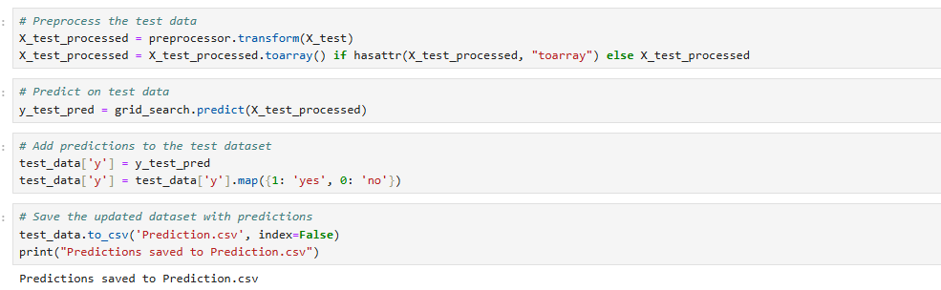
Preprocessing: The test data is transformed using a preprocessor, and sparse data is converted to dense format if needed.
Prediction: The trained model (grid_search) is used to predict labels for the test data.
Update Dataset: Predictions are added to the test dataset and mapped to "yes"/"no" labels.
Save Results: The updated dataset is saved to a CSV file named Prediction.csv.

Slide 11
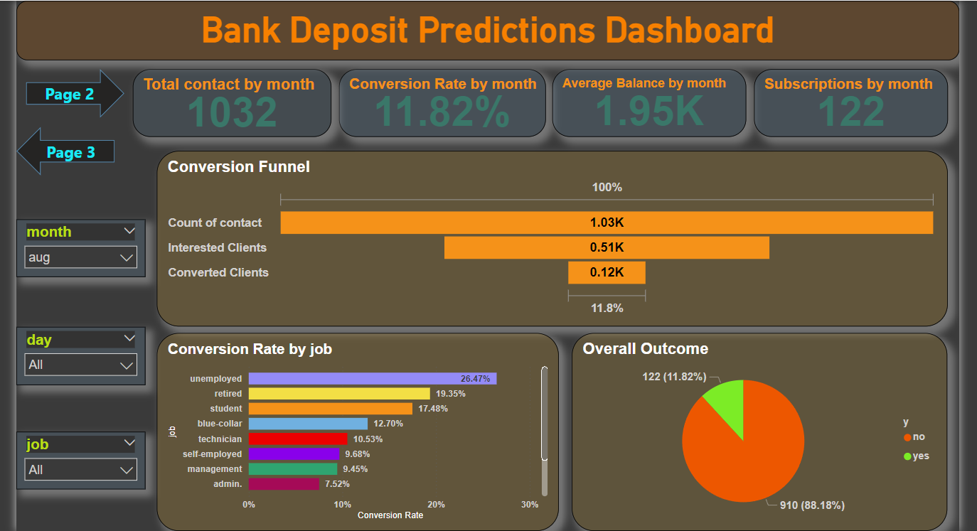

Slide 12
Total Contacts: In the selected month (August), 1032 people were contacted.
Conversion Rate: The overall conversion rate for the month is 11.82%, meaning about 1 in 9 contacted individuals became subscribers.
Average Balance: The average balance for clients contacted is approximately 1.95K (currency unspecified).
Subscriptions Achieved: Out of the total contacts, 122 individuals subscribed to the bank's services.
Conversion Funnel:
Total Contacts: 1.03K individuals were reached.
Interested Clients: 0.51K clients showed interest (about 50% of those contacted).
Converted Clients: 0.12K clients subscribed (about 11.8% of the total contacted).

Slide 13
Conversion by Job Role:
The highest conversion rate is observed in the "unemployed" group (26.47%).
Other high-conversion groups include "retired" (19.35%) and "students" (17.48%).
Lower conversion rates are seen in "administration" (7.52%) and "management" (9.45%).
Overall Outcome:
Converted: 122 (11.82%).
Not Converted: 910 (88.18%)

Slide 14
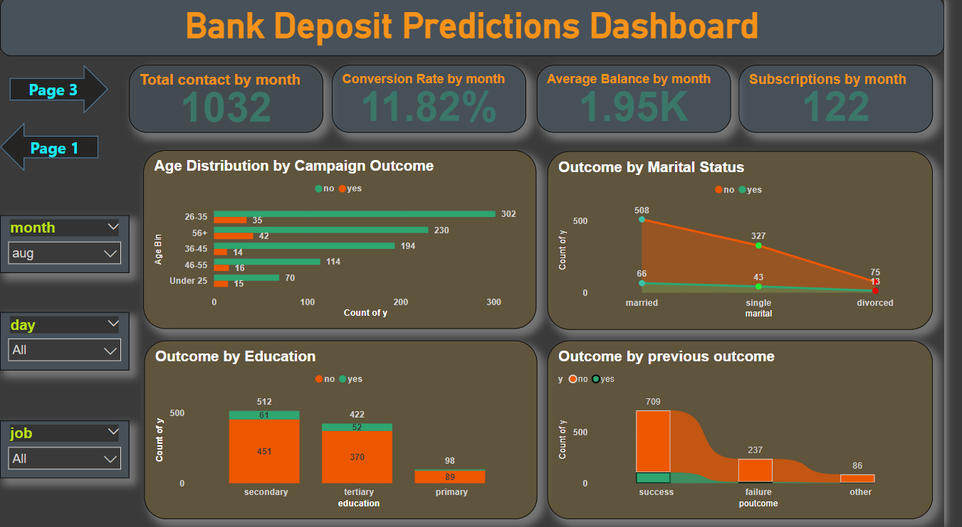

Slide 15
General Campaign Performance
Total Contacts: 1032 people contacted in August.
Conversion Rate: 11.82% of contacts converted.
Subscriptions: 122 successful subscriptions in the selected month.
Average Balance: 1.95K (currency unspecified) for clients contacted.
Age Distribution by Campaign Outcome
Best Converting Age Group: Ages 26-35 with 35 successful conversions out of 337 contacts.
Other High-Performing Groups:
Ages 56+ have 42 successful conversions.
Ages 36-45 have 30 conversions but a lower success percentage.
Lowest Performing Group: Under 25 with 15 conversions from 85 contacts.

Slide 16
Outcome by Marital Status
Highest Success: Married individuals have the most conversions (66), though with 508 unsuccessful outcomes.
Single Individuals: 43 conversions out of 370 total contacts.
Divorced Individuals: Lowest success rate with only 13 conversions out of 88 contacts.
Outcome by Education
Secondary Education: Highest conversions (61) out of 512 contacts.
Tertiary Education: 52 conversions from 422 contacts, indicating a strong performance.
Primary Education: Low success rate with 89 conversions from 187 contacts.
Outcome by Previous Outcome
Strong Positive Correlation with Success:
Clients with a successful previous outcome contributed 86 successful conversions out of 709.
Failure and Other Outcomes: Relatively low conversions, with only 36 successes from failed prior outcomes and 89 successes from other outcomes.

Slide 17
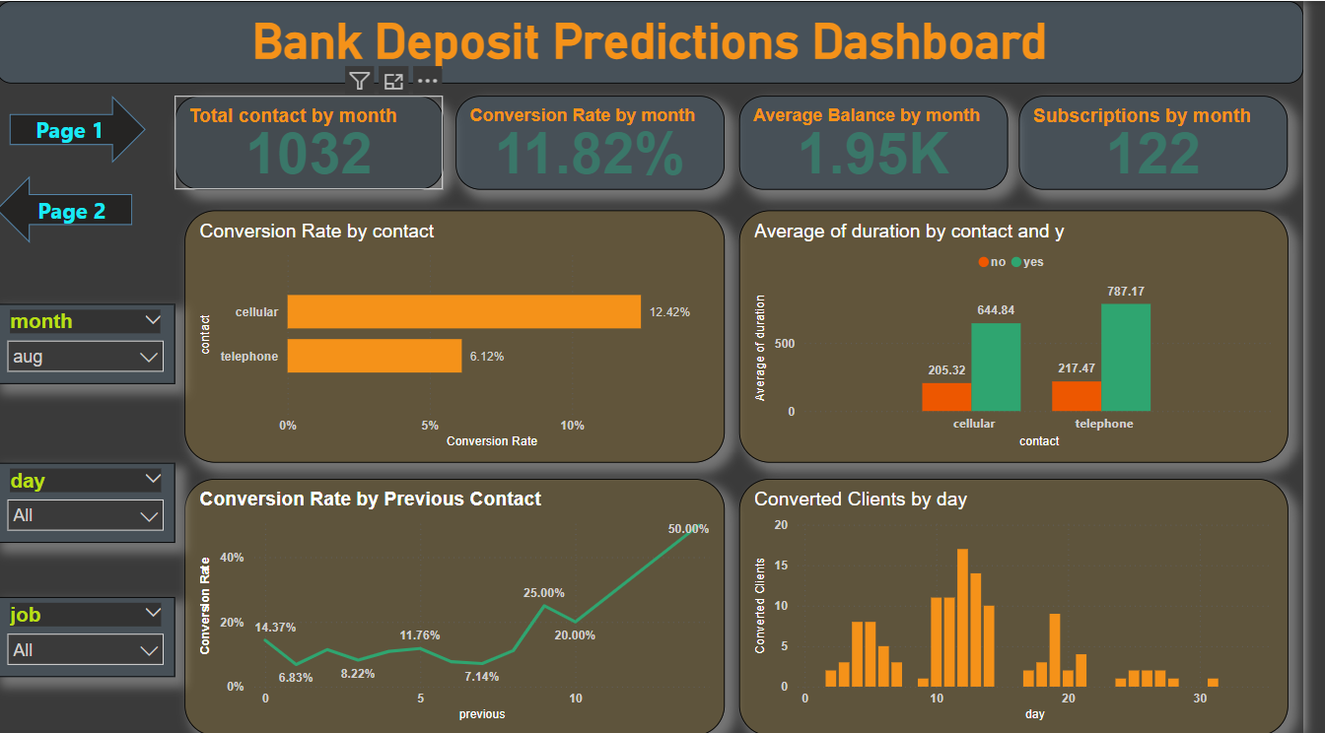

Slide 18
Contact Method Performance
Cellular Contact:
Higher conversion rate (12.42%) compared to telephone.
Average duration for successful calls is 644.84 seconds, much higher than unsuccessful calls (205.32 seconds).
Telephone Contact:
Lower conversion rate (6.12%).
Successful calls last an average of 787.17 seconds, compared to 217.47 seconds for unsuccessful calls.
Impact of Previous Contact
Conversion Rate Trends:
No previous contact has a lower conversion rate (~6.83%).
Clients with 1-3 previous contacts show steady improvement in conversion rates (11.76%-20%).
A significant jump is observed for clients with 4+ previous contacts, reaching 50% conversion.

Slide 19
Daily Conversion Trends
Conversion Clusters:
Peaks observed on days 8, 15, and 22, indicating higher engagement or effectiveness of campaigns on these specific days.
Minimal conversions occur on other days, suggesting uneven performance across the month.

Slide 20
Conclusion
Our project successfully highlights the potential of predictive analytics in enhancing targeted marketing strategies for banking institutions. Through detailed data analysis, we identified key factors influencing customer decisions and built a predictive model to optimize resource allocation and improve conversion rates.
Key Takeaways:
Insights-Driven Marketing: The model enables efficient targeting of high-potential customers, boosting campaign efficiency.
Performance Metrics: High accuracy was achieved, though there’s room for improvement in handling minority class predictions.
Actionable Insights: Analysis of demographics, contact methods, and campaign trends provides valuable recommendations for future strategies.
Future Scope:
Further refine the model to improve recall for minority classes.
Incorporate additional features or data sources for better predictions.
Use insights to design more balanced and effective marketing campaigns.
By leveraging predictive analytics, this project demonstrates how banks can transform raw data into actionable intelligence, paving the way for more effective and customer-centric marketing efforts.

